Slide 1
Problem Statement
Vehicle Cut-in Detection
In this project, we have created few machine learning models comprising of detection of vehicles, its type, distance of the vehicle from the observer vehicle and the approximate time of collision.
link to github : https://github.com/DipanwitSen/ADAS

Slide 2
Dataset:
Traffic signal:
https://www.kaggle.com/datasets/meowmeowmeowmeowmeow/gtsrb-german-traffic-sign
Kiiti Dataset:
https://www.kaggle.com/datasets/garymk/kitti-3d-object-detection-dataset
Clean Vehicle Dataset:
https://www.kaggle.com/datasets/jatindulani31/cleaned-vehicle-datas
Indian Dataset:
https://www.kaggle.com/datasets/dataclusterlabs/indian-vehicle-dataset

Slide 3
Unique Idea Brief (Solution):
Kalman model : In this, we have researched about Kalmel filter, an unique iterative mathematical process, which uses set of equations and consecutive data inputs to quickly estimate the true value, position and velocity of the object being measured.
3D model : In this model, we have tried to intoduce LIDAR based sensoring, which creates a 3D point cloud represnting the surroundings with high accuracy. It also creates 3D bounding boxes around surrounding objects and returns the location, dimensions and orientations of the object.

Slide 4
Features Offered:
Lane Detection model : This model leverages computer vision techniques for real time lane detection transforming the road view to a bird’s eye perspective and applying dynamic thresholding and sliding windows for accurate lane line identifaction. This is crucial for applications in autonomous driving and advanced driver assistance systems (ADAS).
2D Model : This model leverages the YOLO object detection algorithm to process visual inputs from images, videos, and webcam streams. It provides valuable real-time insights and warnings for potential collisions by calculating the distance and speed of detected objects.

Slide 5
Process flow:
The model works in the following way:
Import necessary libraries.
Define object dimensions, camera focal length, class names, and thresholds.
Load a YOLO model and create output directory.
Initialize global variables for distance, time, and speed.
Prompt user for input type (webcam, image, video).
Read and process frames from a video file.
Filter detections based on confidence threshold.
Calculate distance, speed, and time to collision.
Annotate image with bounding boxes, speed, distance, and time to collision.
Issue warnings if time to collision is below a threshold.

Slide 6
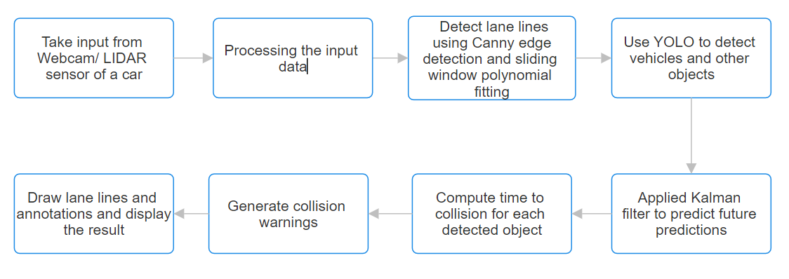
Architecture Diagram:

Slide 7
Technologies used / approach:
Libraries used in the model are :
Python : Main programming language used for implementation.
OpenCV : For image and video processing tasks.
NumPy : For numerical operations and array handling.
Ultralytics YOLO : For object detection.
Kalman Filter : Tried to introduce this model for choosing an efficient car’s path after detecting an obstruction.
Models and Algorithms used are:
YOLOv8 Model: Pre-trained YOLOv8 model for real-time object detection.
Non-Maximum Suppression (NMS): For filtering overlapping bounding boxes based on confidence scores.
KITTI Dataset : For evaluating computer vision

Slide 8
Issues Faced:
The issues faced during the completion of the project are :
Could not use IDD dataset and had many problems in finding real-time data. Hence we had to take all the required dataset from kaggle .
Debugging the code and understanding the maths behind many of algorithm was tough but thanks to our mentor from college as well as intel who enlighted us on our way.
We pay our gratitude to Jayeeta Chakraborty ma'am and Amartya sir for guiding us.

Slide 9
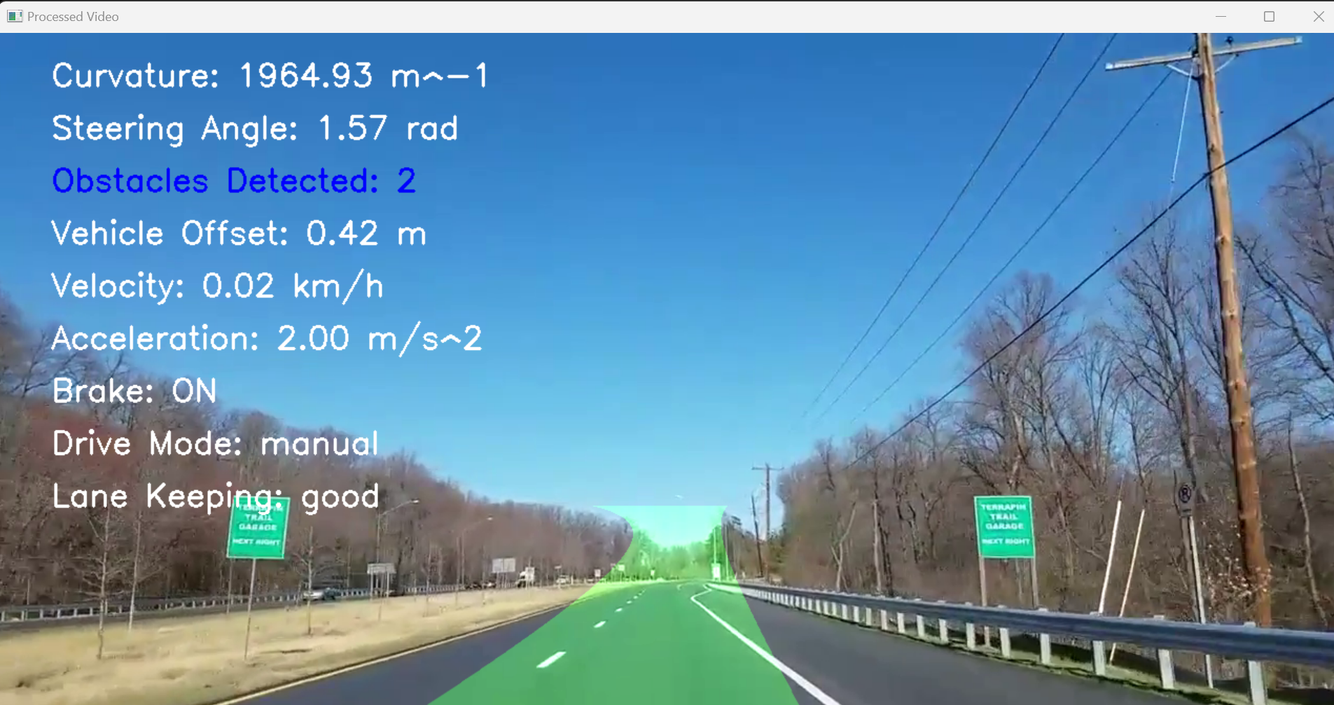
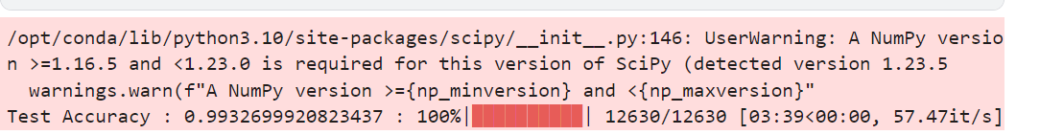
RESULT:

Slide 10
Team members and contribution:
DIPANWITA SEN - 22052204 : Done coding for the 2d.py, car_annotation.py, lane_detection.py, combined.py and have also reseached about kalman filter.
SUDEEP DUTTA-22052252 : Have done debugging and created a word document as well as the ppt for the project.
AMISHI AGARWAL-22051917 : nil contribution.
PARTH SACHDEVA-22051957 : nil contribution.

Slide 11
Conclusion
The model implements the advanced vehicle cut in detection system using computer vision and deep learning algorithms. It processes various types of inputs to detect lane lines and obstacles on the road. The model calculates critical parameters like lane curvature, vehicle offset, and time to collision, providing real-time feedback and collision warnings. By integrating Kalman filtering for object tracking and YOLO for obstacle detection, the model enhances situational awareness and safety in autonomous driving scenarios. The final output includes annotated visuals with essential driving information, demonstrating a robust approach to real-time vehicle environment perception and decision-making.

